Slide 1
2 tam giac dong dang (truong hop 1)

Slide 2
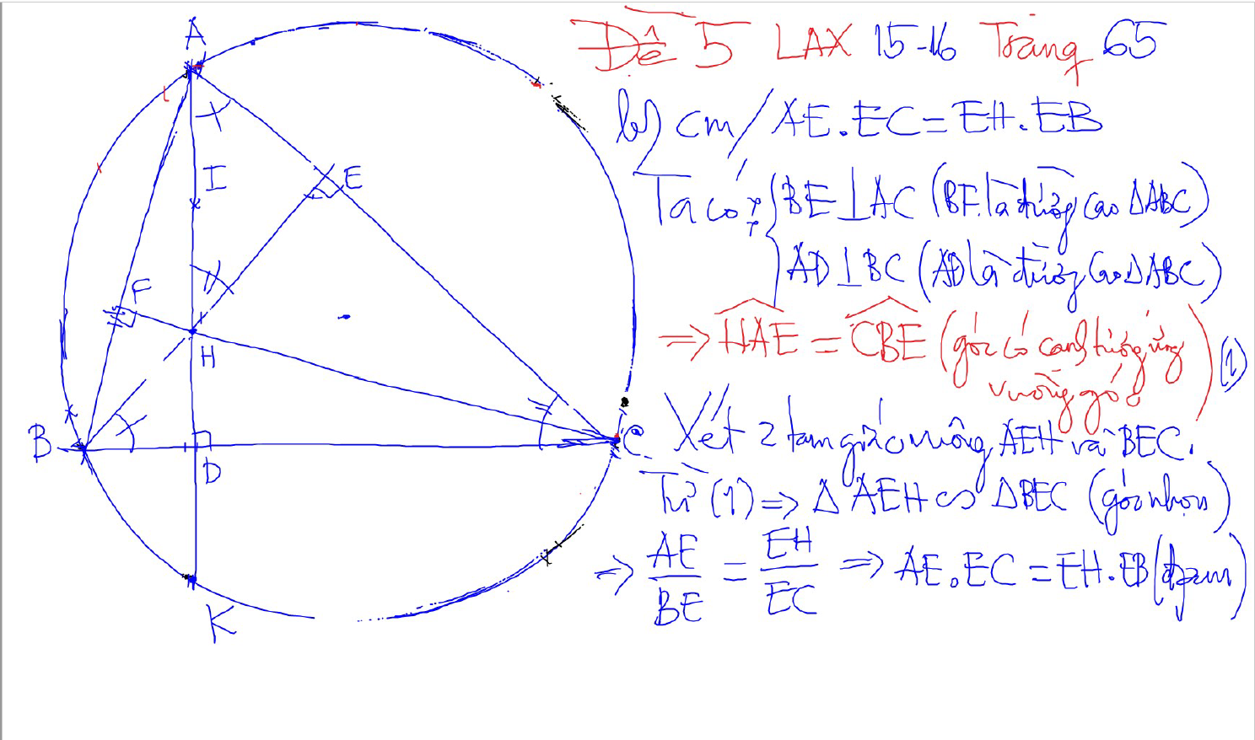
2 tam giac dong dang (truong hop 1)
2 goc bang nhau
1 goc nhon bang nhau

Slide 3
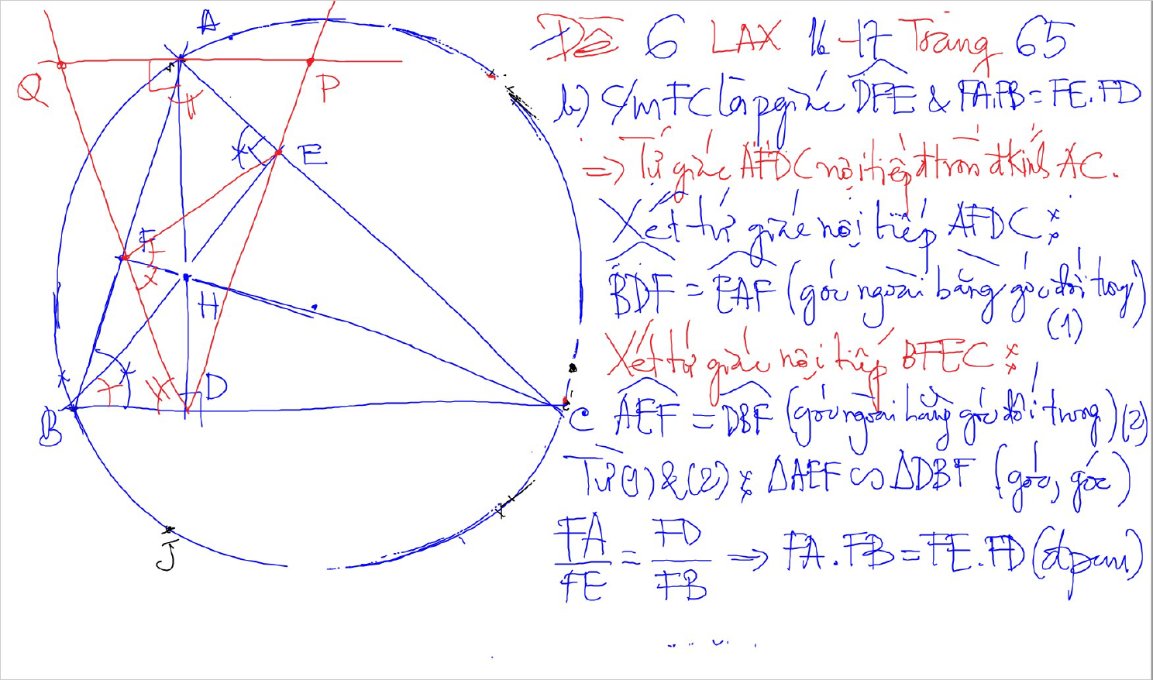
2 tam giac dong dang (truong hop 1)
2 goc bang nhau
1 goc nhon bang nhau

Slide 4
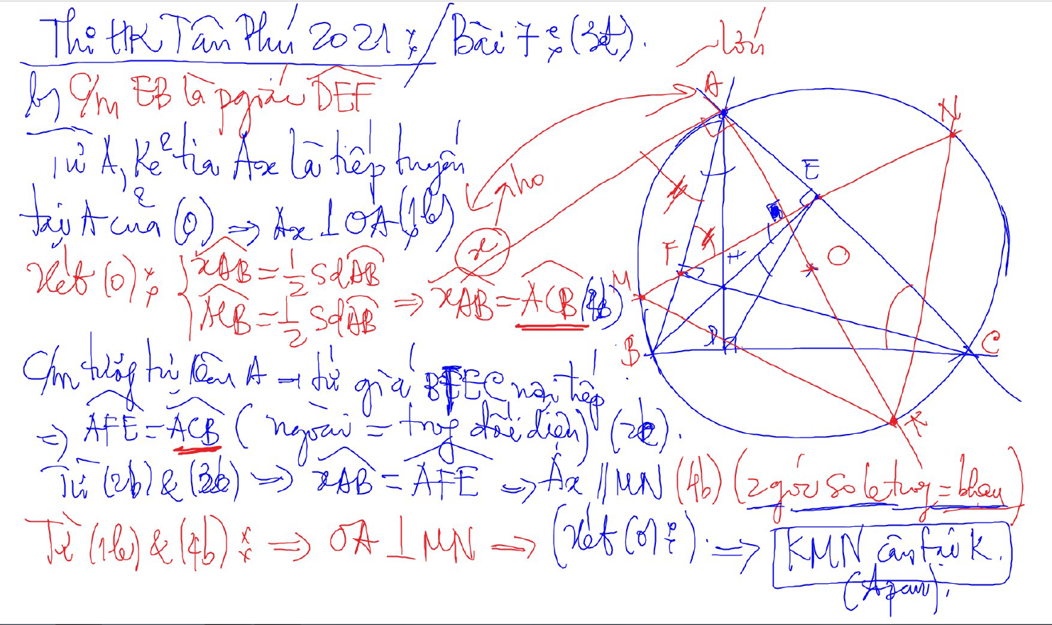
C/m tam giac dong dang truong hop 2

Slide 5
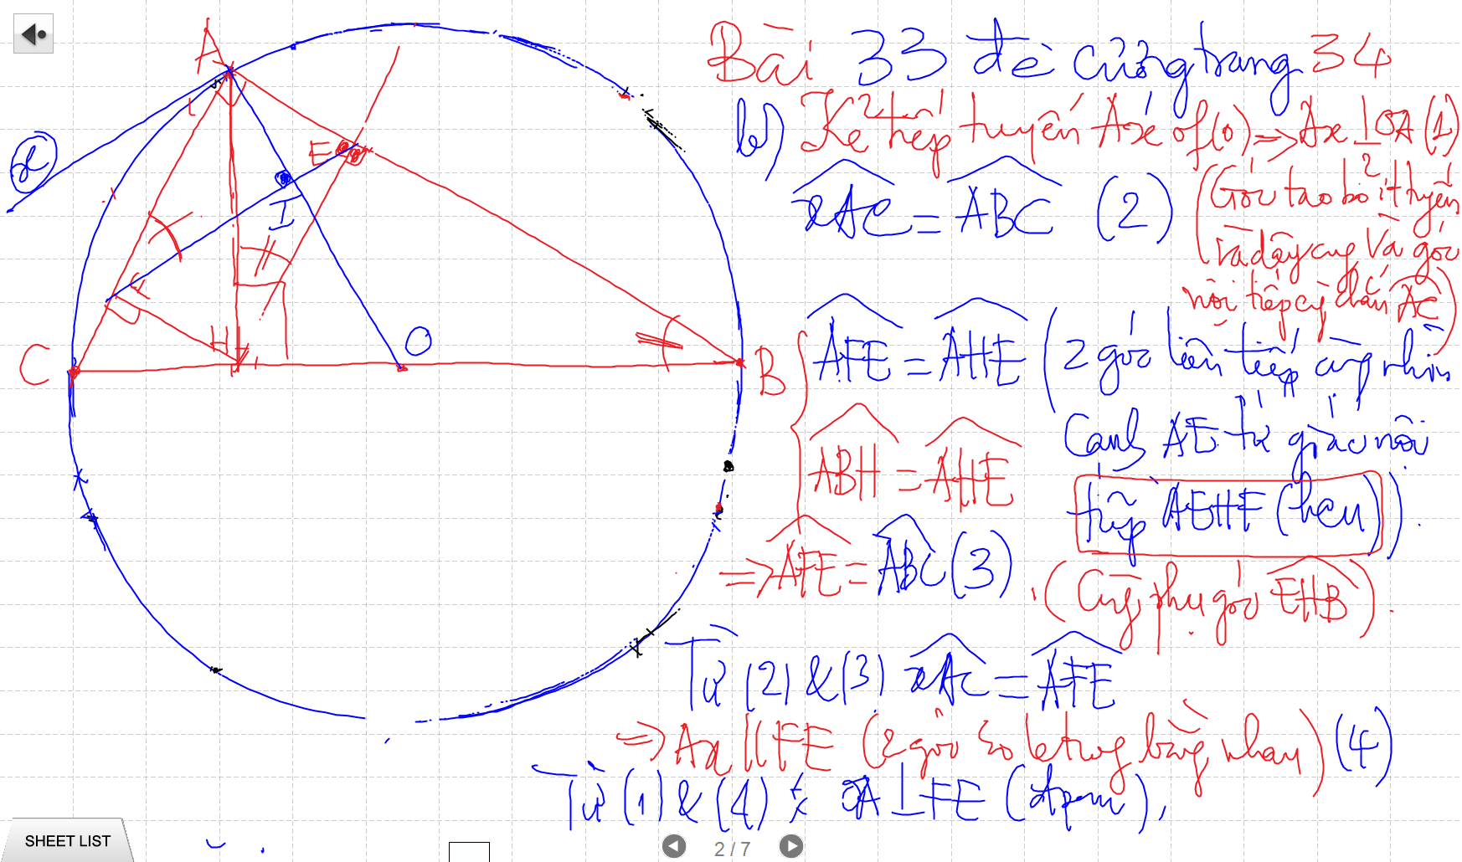
C/m tam giac dong dang truong hop 2

Slide 6
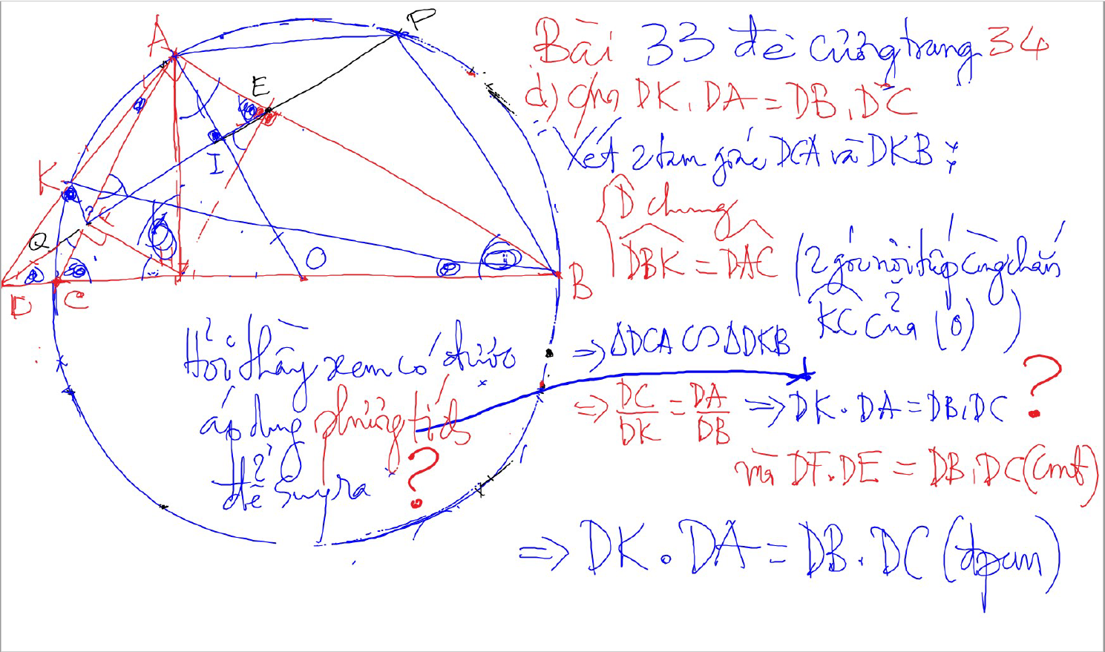
C/m tam giac dong dang truong hop 2

Slide 7
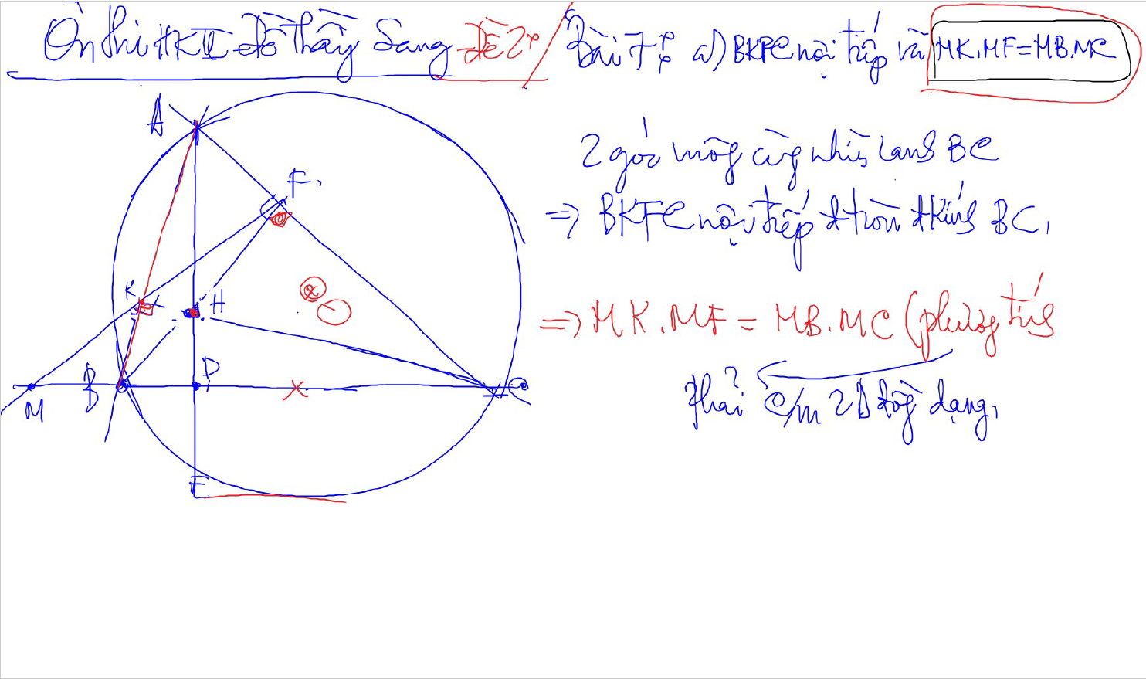
C/m tam giac dong dang truong hop 2

Slide 8
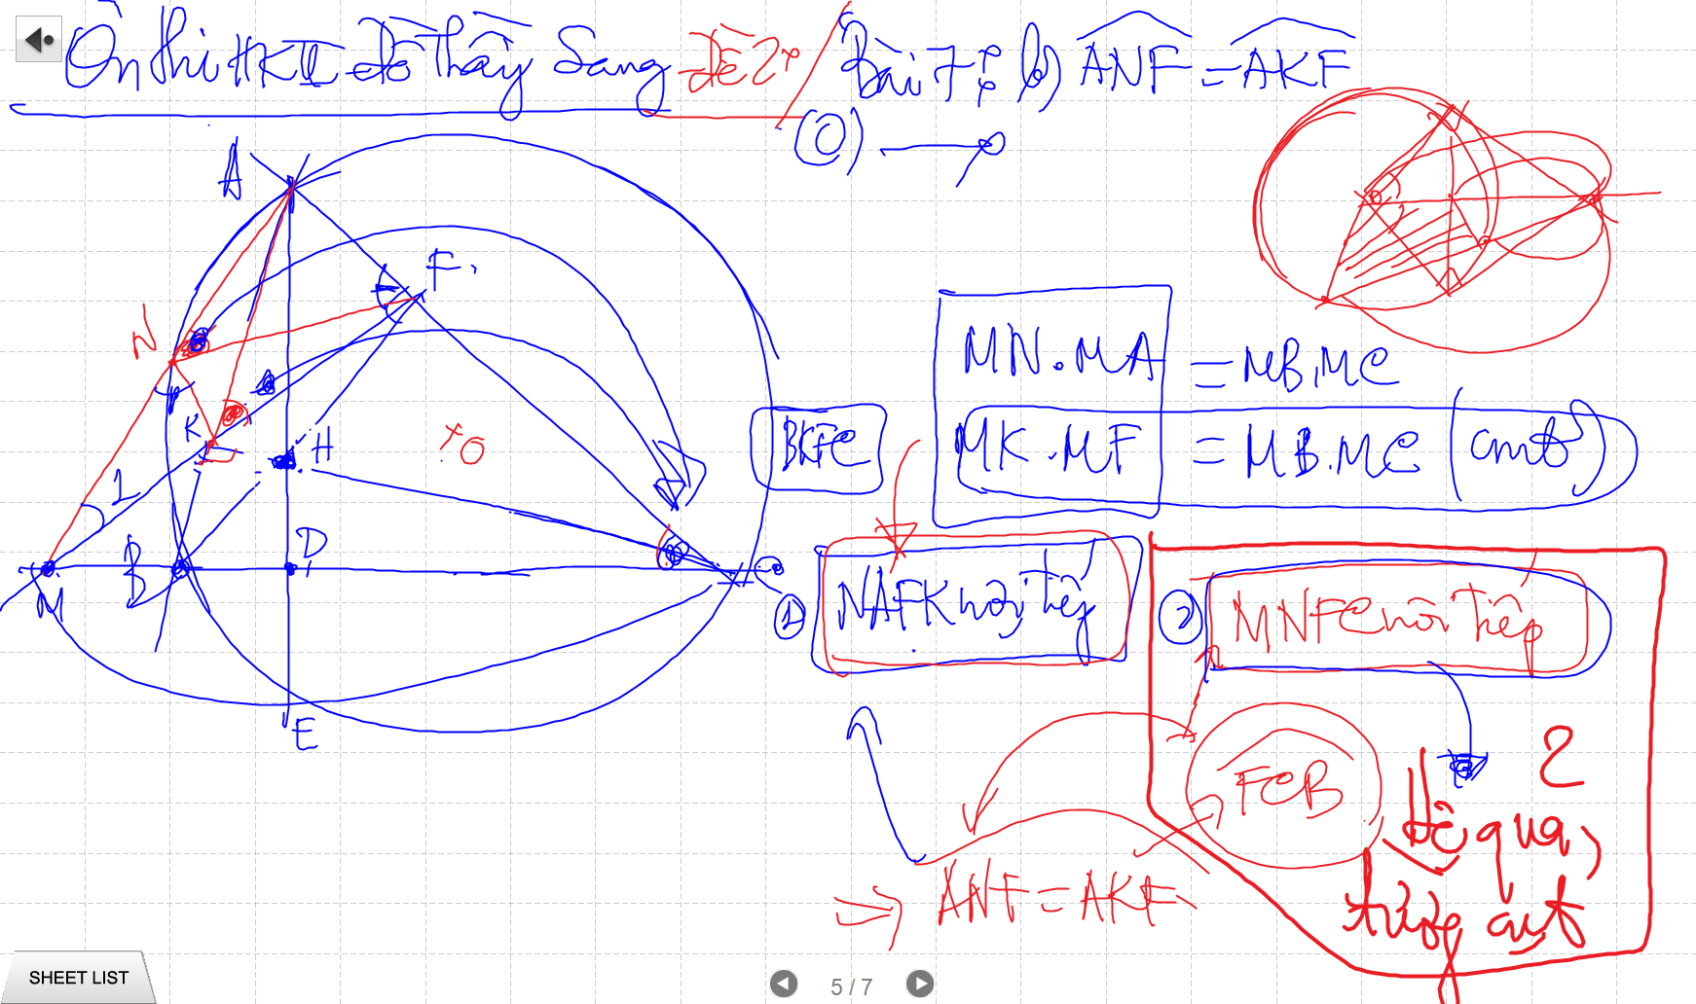
C/m tam giac dong dang truong hop 2

Slide 9
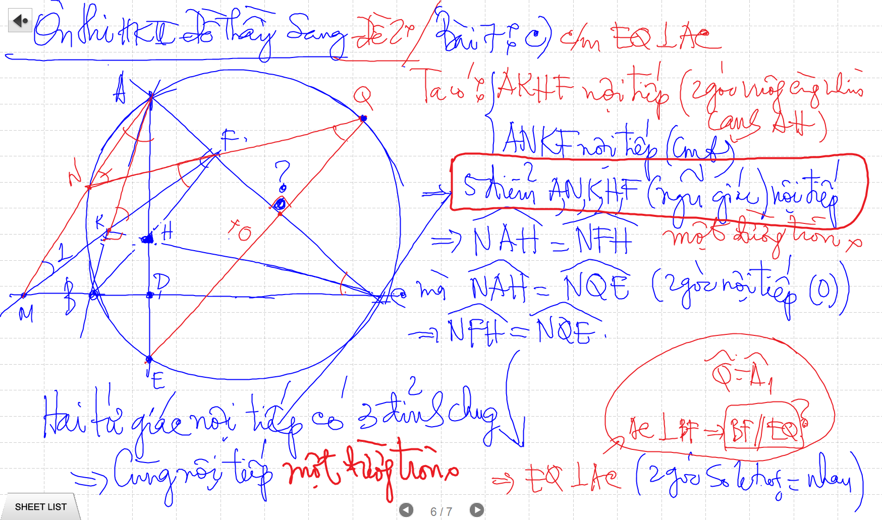

Slide 10
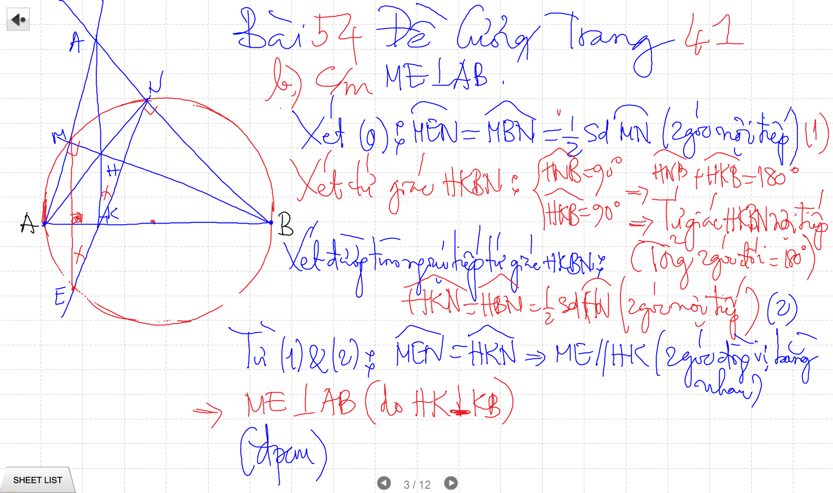

Slide 11
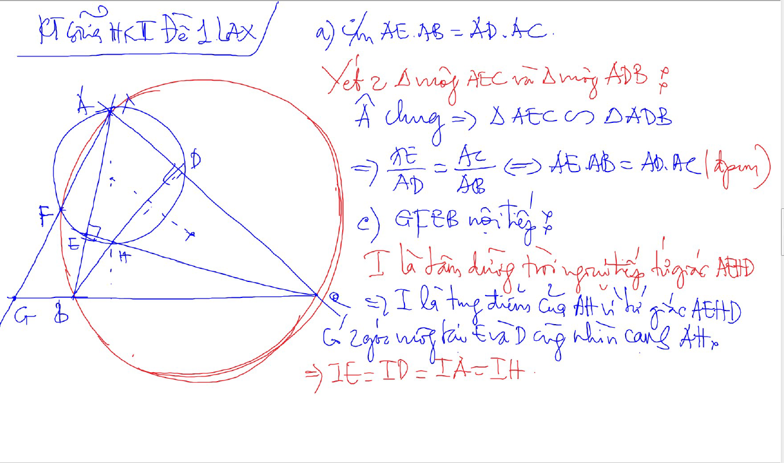

Slide 14
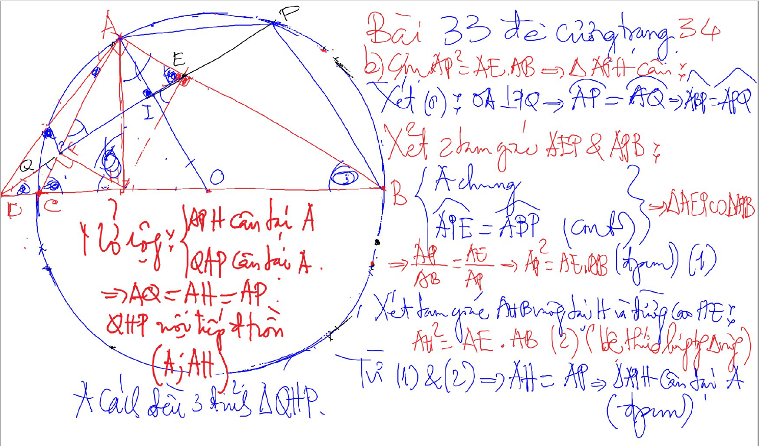
Bai 53 De Cuong – Kinh dien tam giac nhon 1 (xem trong thu muc Tu Giac Noi Tiep)

Slide 15
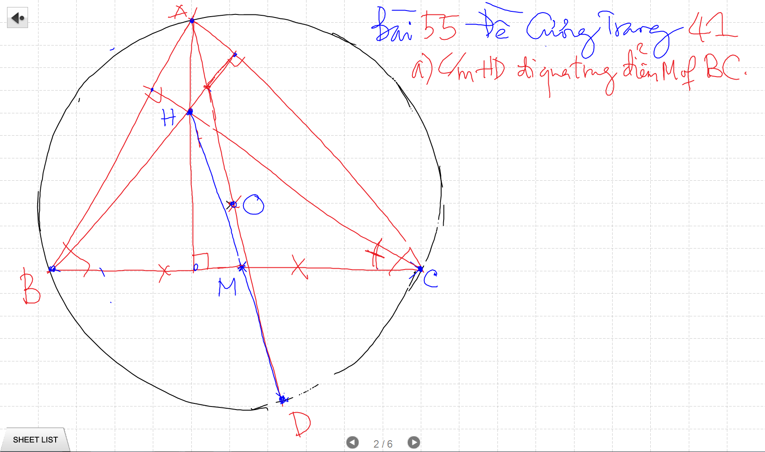

Slide 16
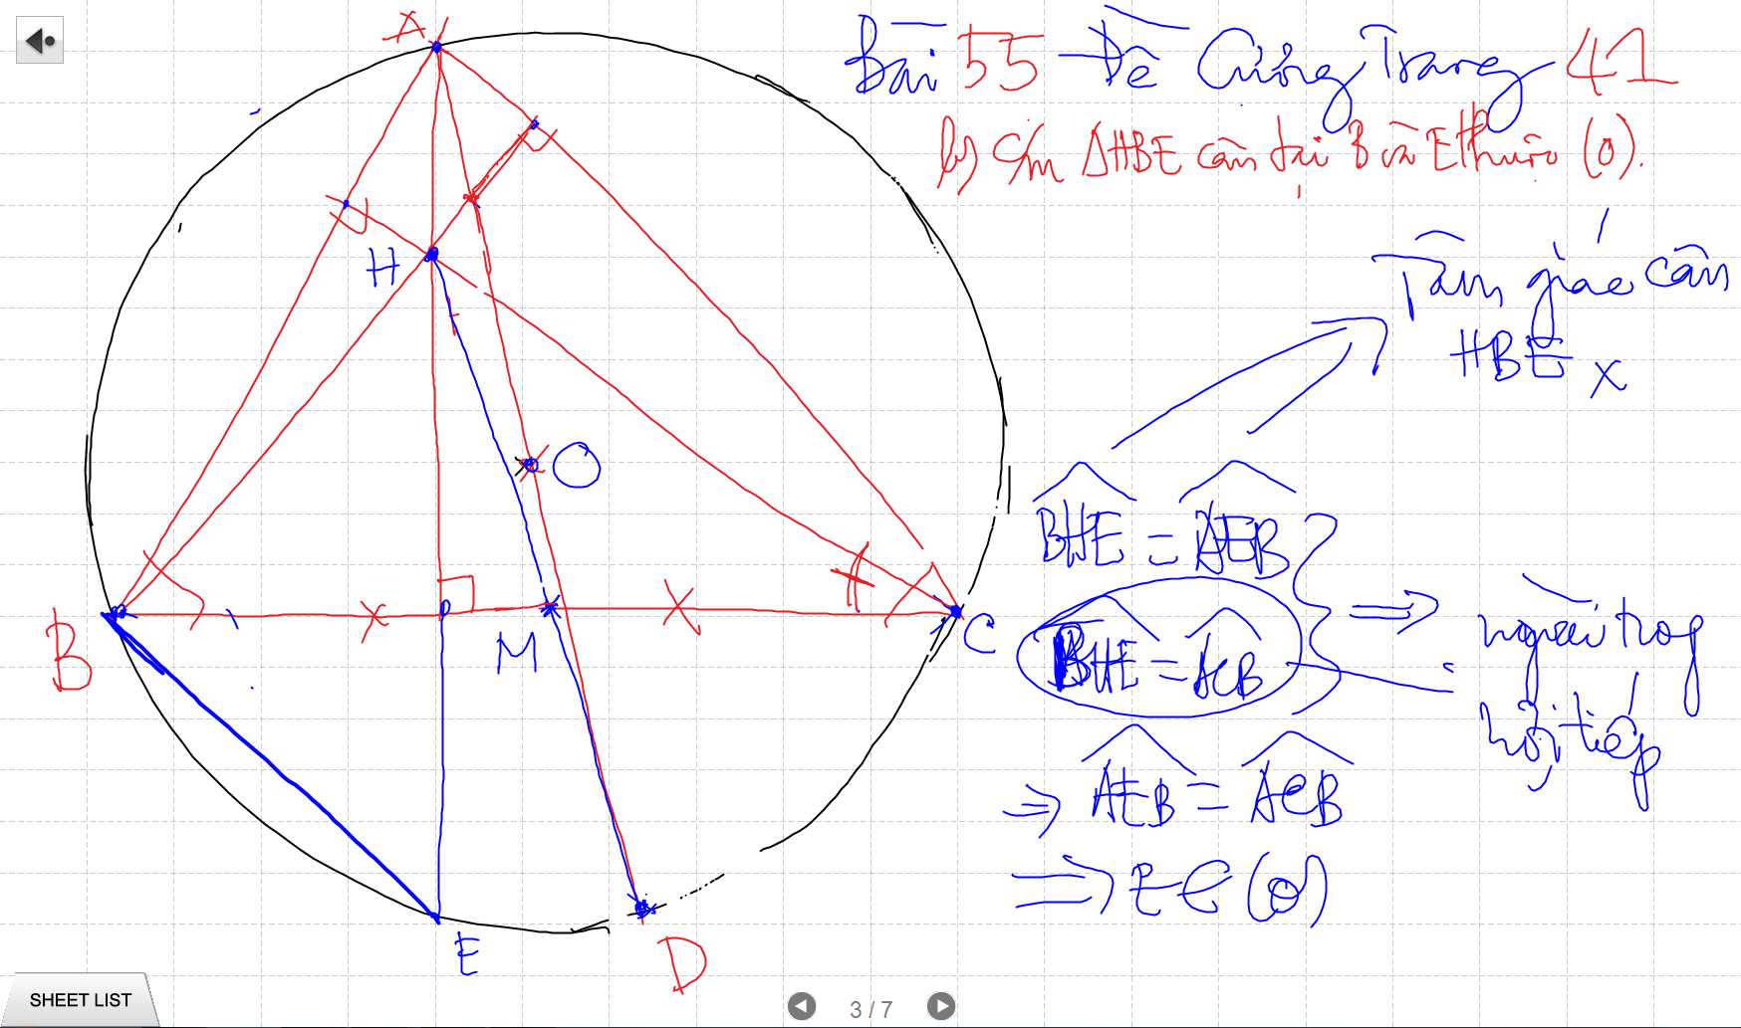

Slide 17
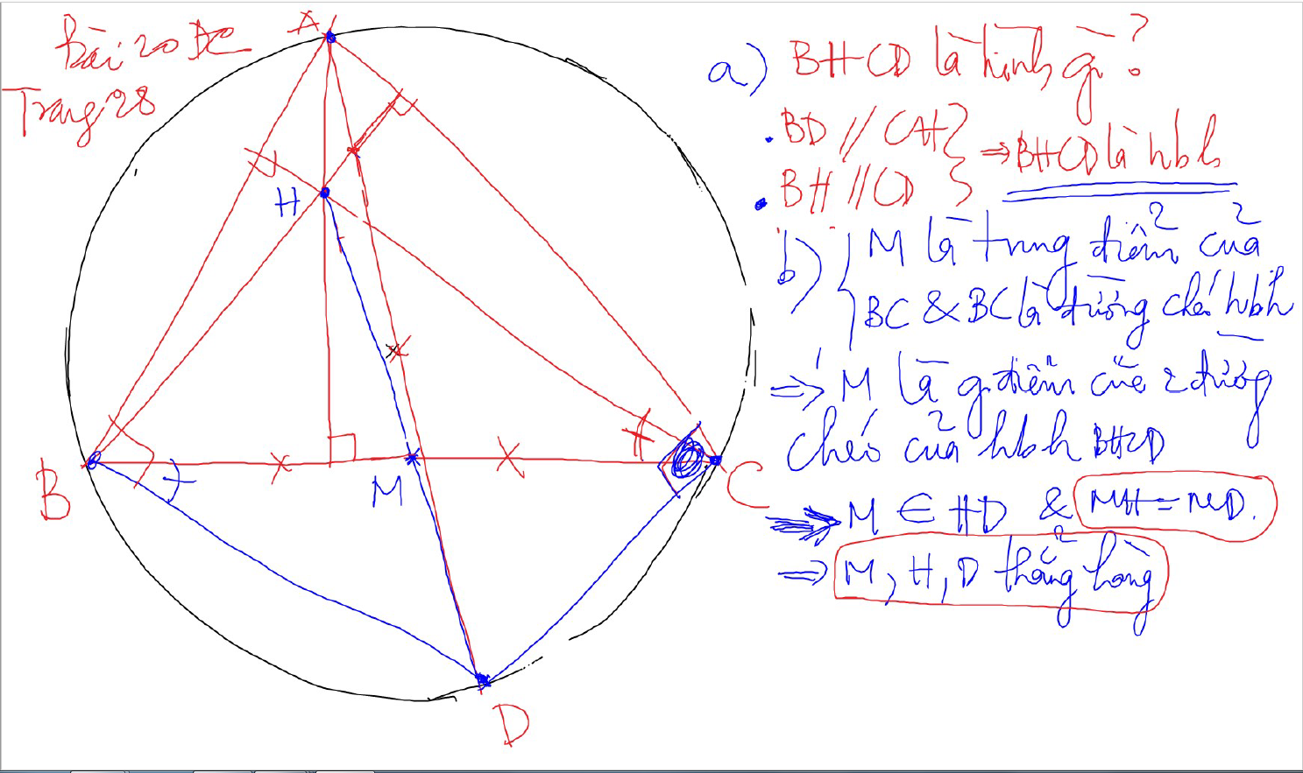

Slide 18
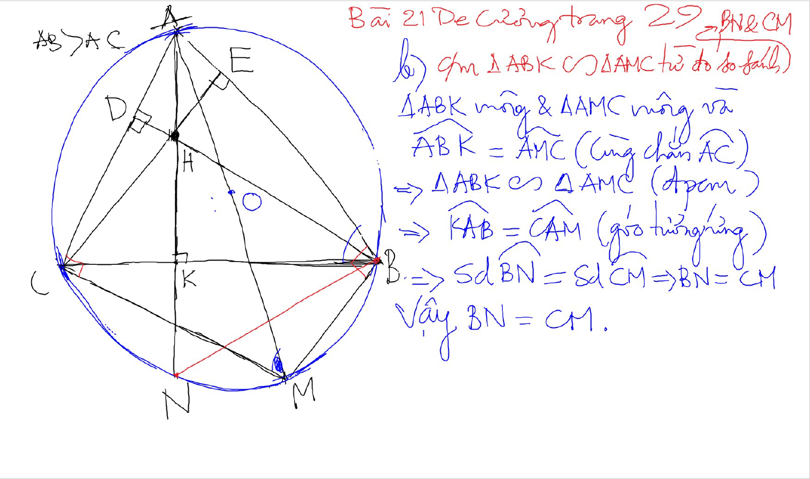

Slide 19
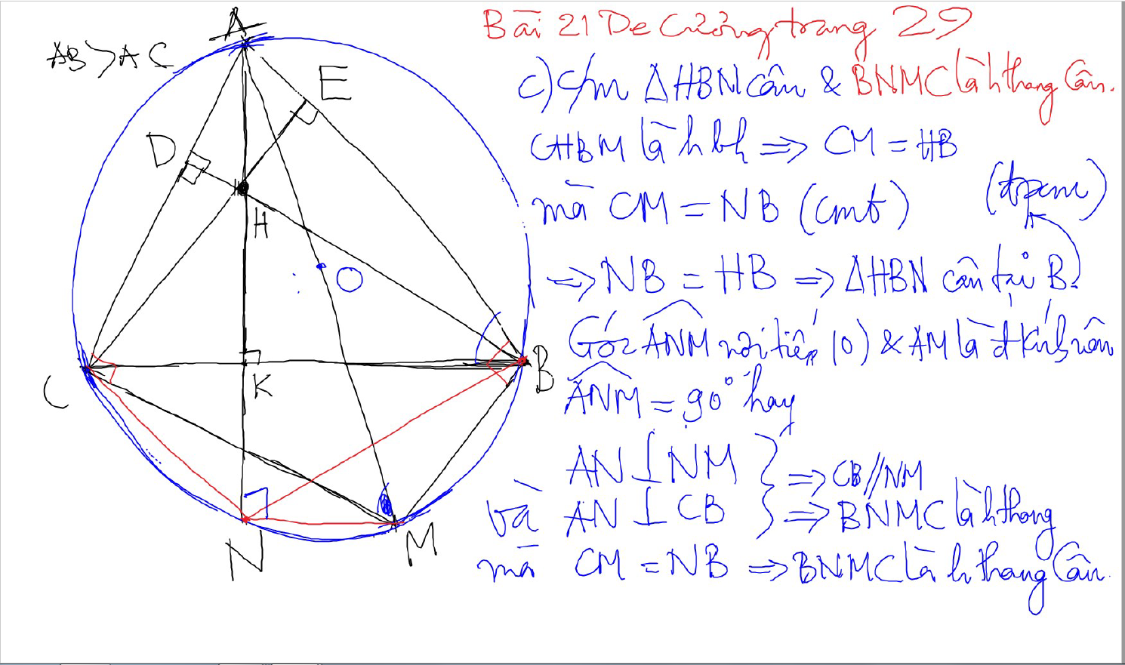

Slide 20
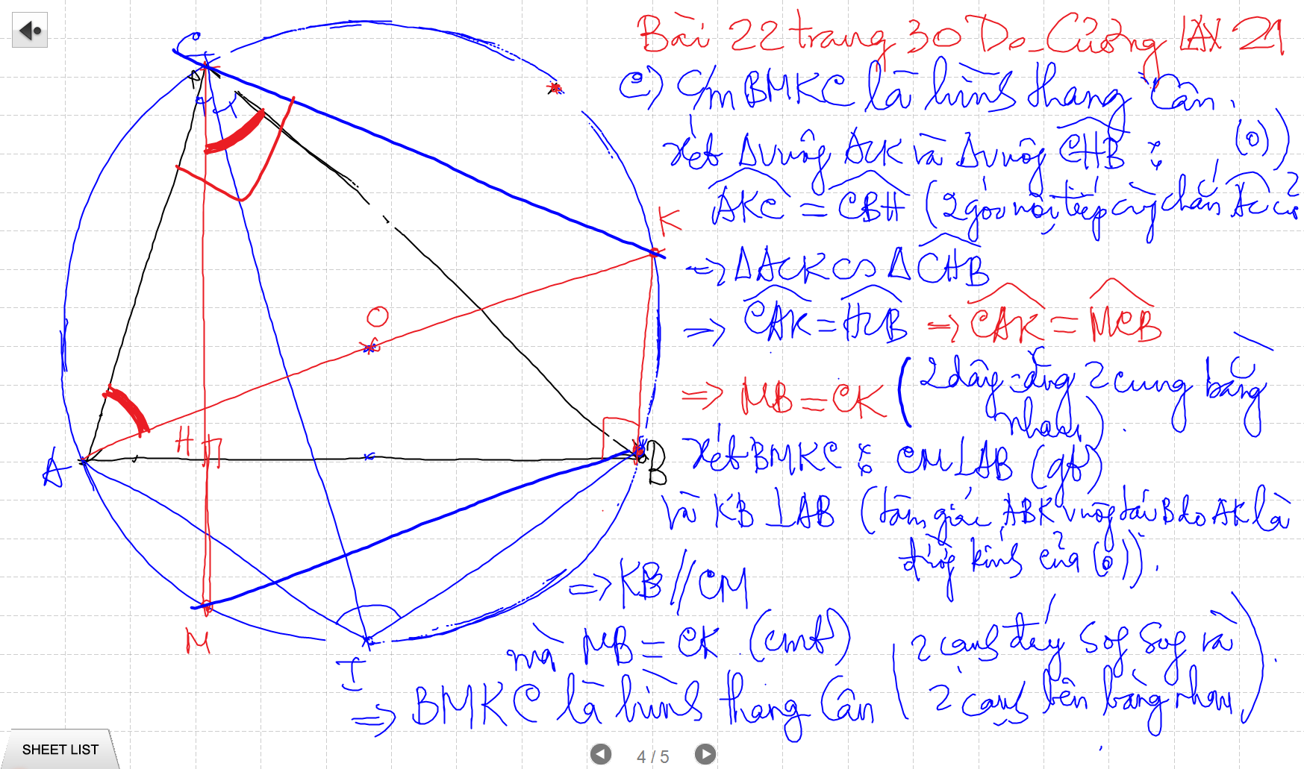

Slide 21
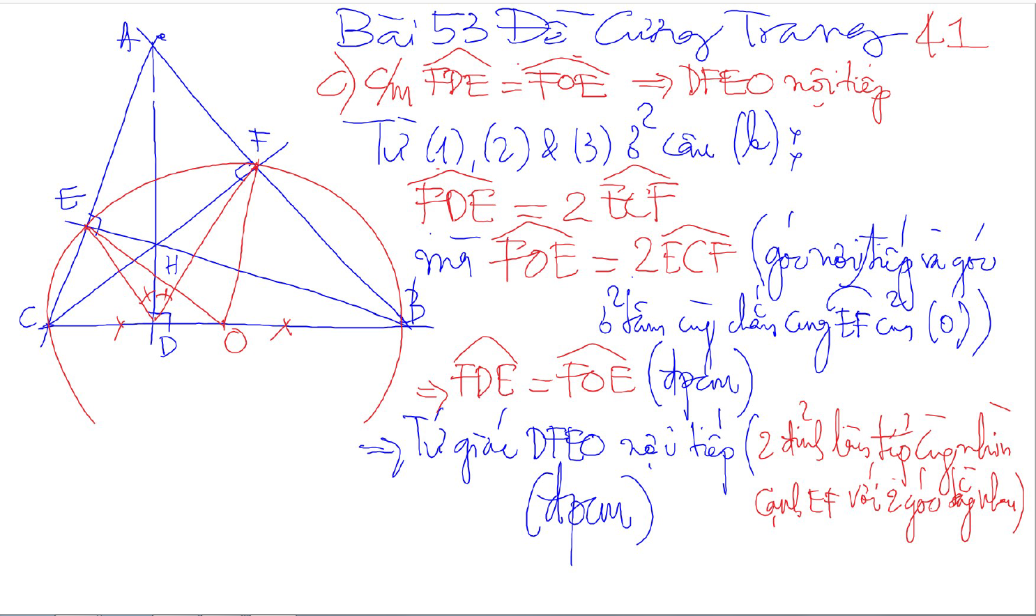
Bai 53 De Cuong – Kinh dien tam giac nhon 1 (xem trong thu muc Tu Giac Noi Tiep)

Slide 22
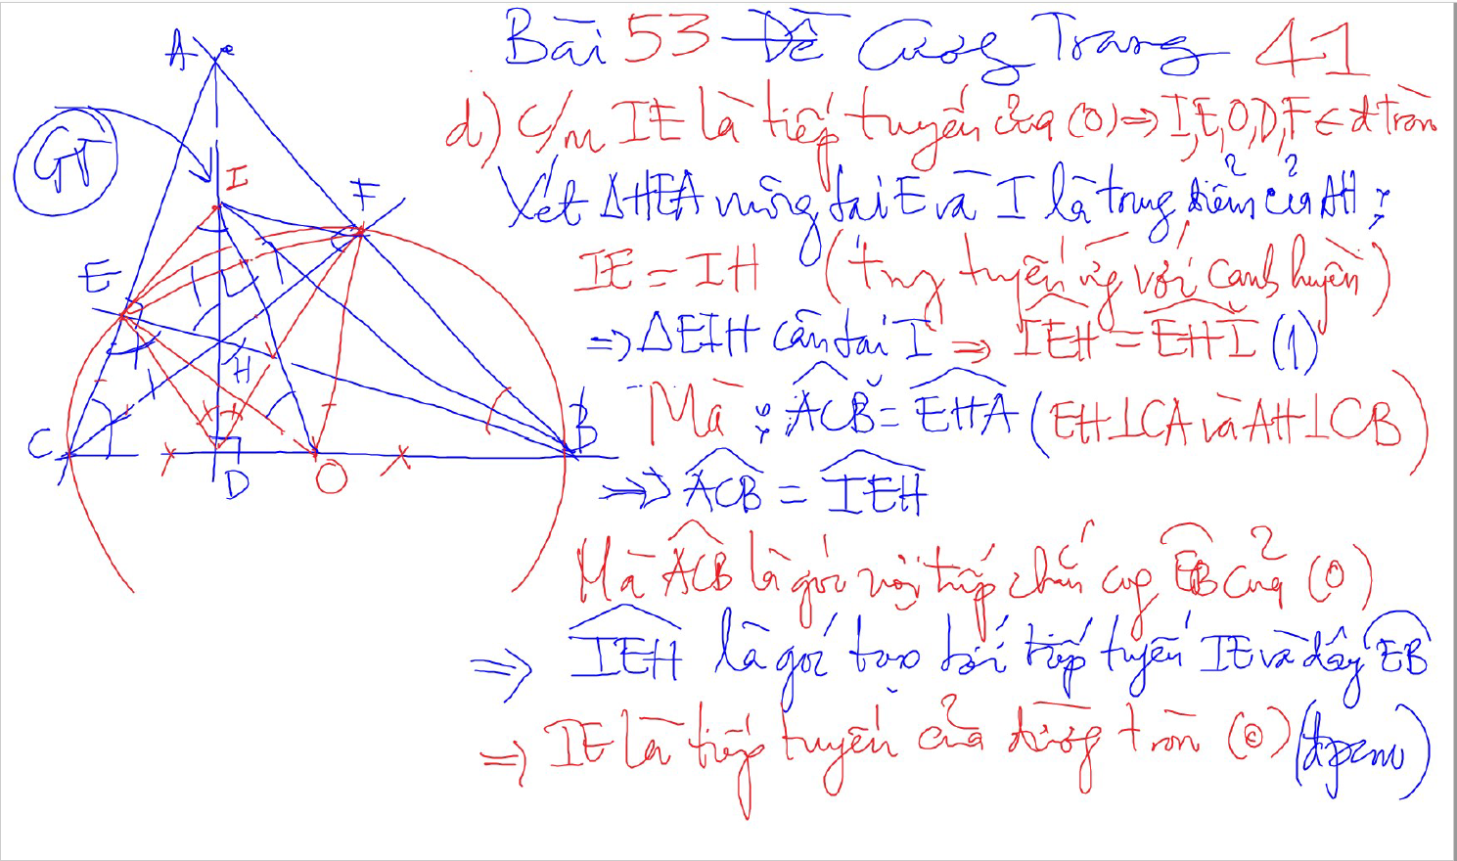
Bai 53 De Cuong – Kinh dien tam giac nhon 1 (xem trong thu muc Tu Giac Noi Tiep)

Slide 23
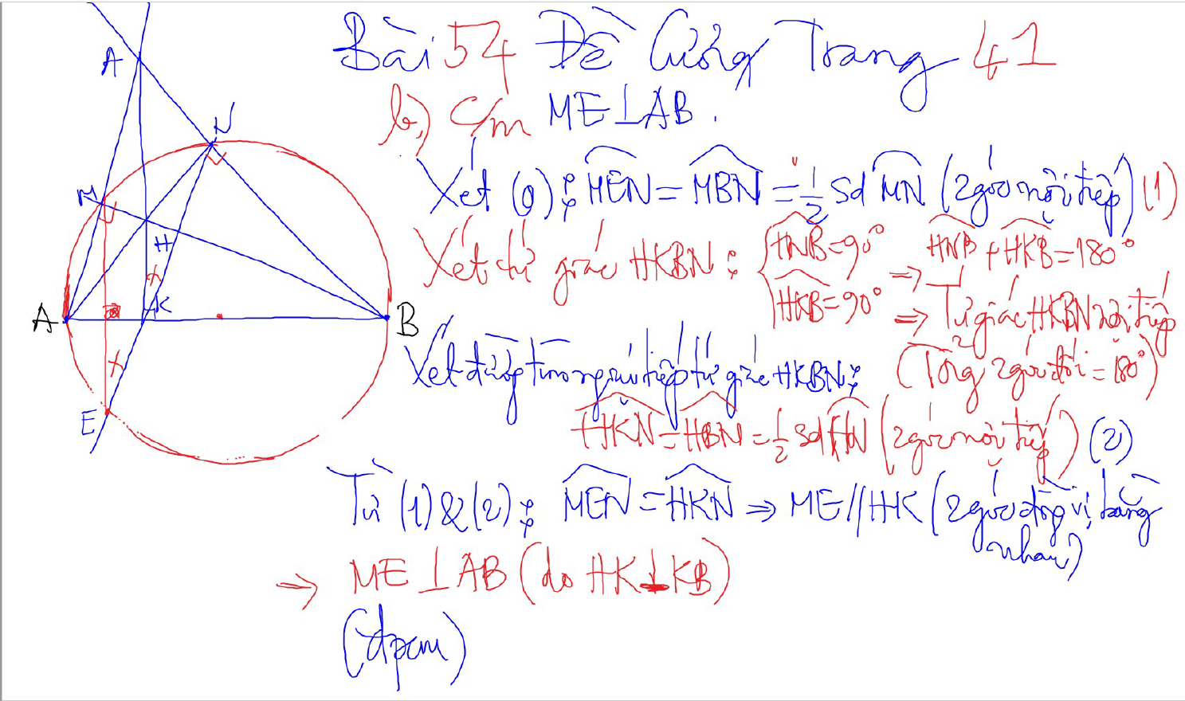
Bai 54 De Cuong – Kinh dien tam giac nhon 1 (xem trong thu muc Tu Giac Noi Tiep)

Slide 24
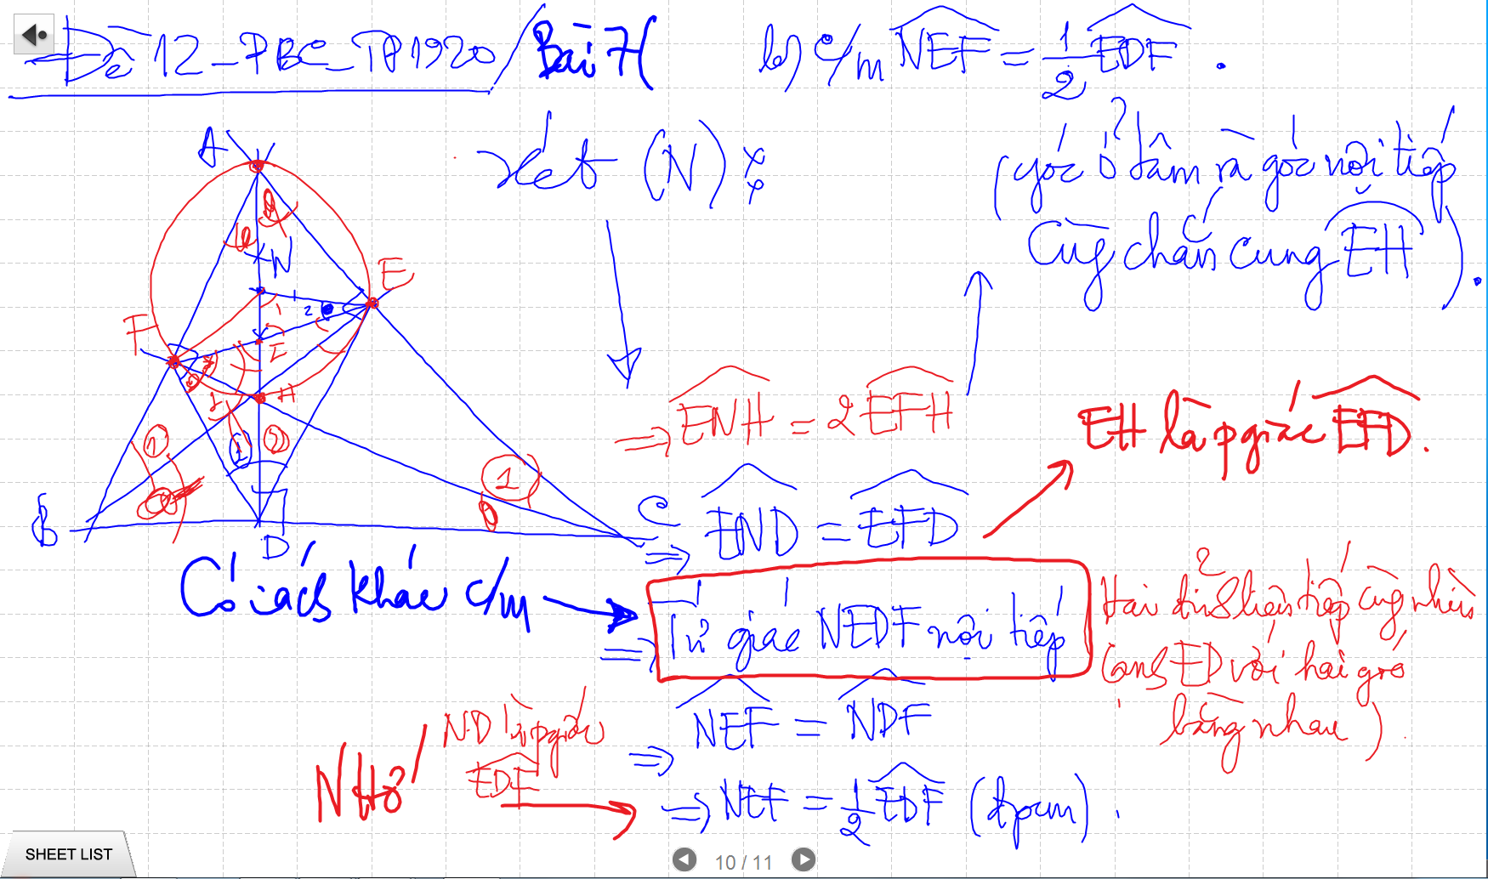
CM TU GIAC NOI TIEP -> SUY RA CAC GOC BANG NHAU

Slide 25
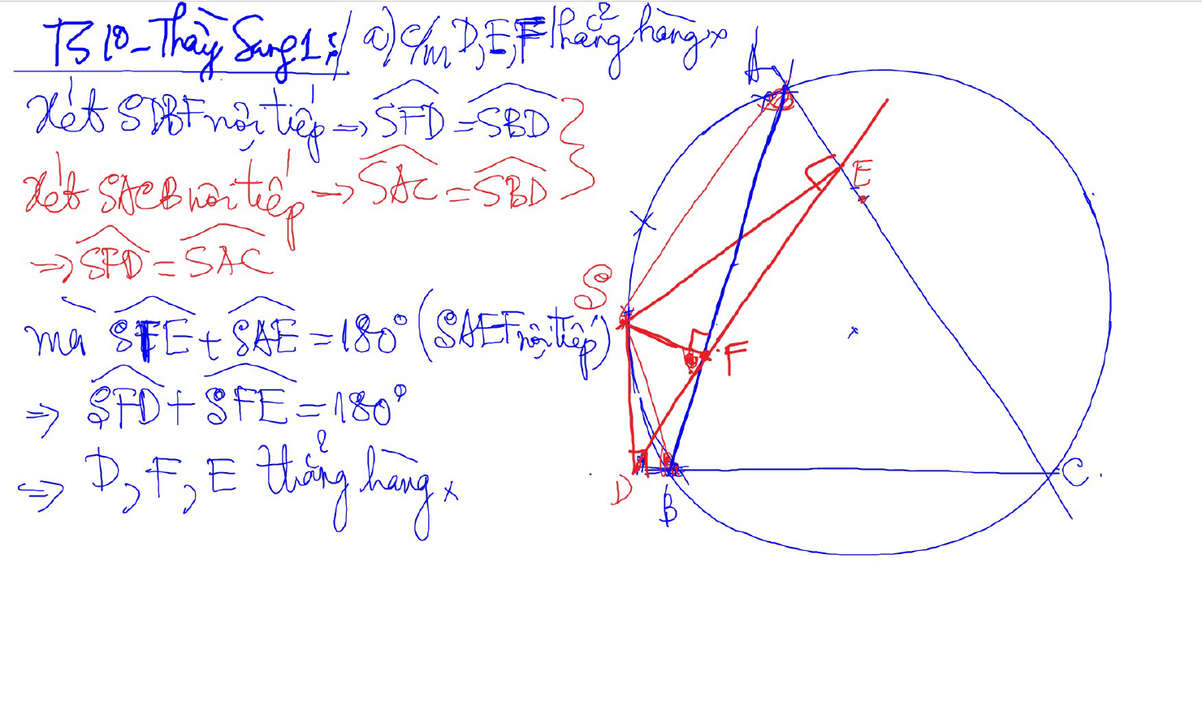
Đường thẳng SIMSON

Slide 26
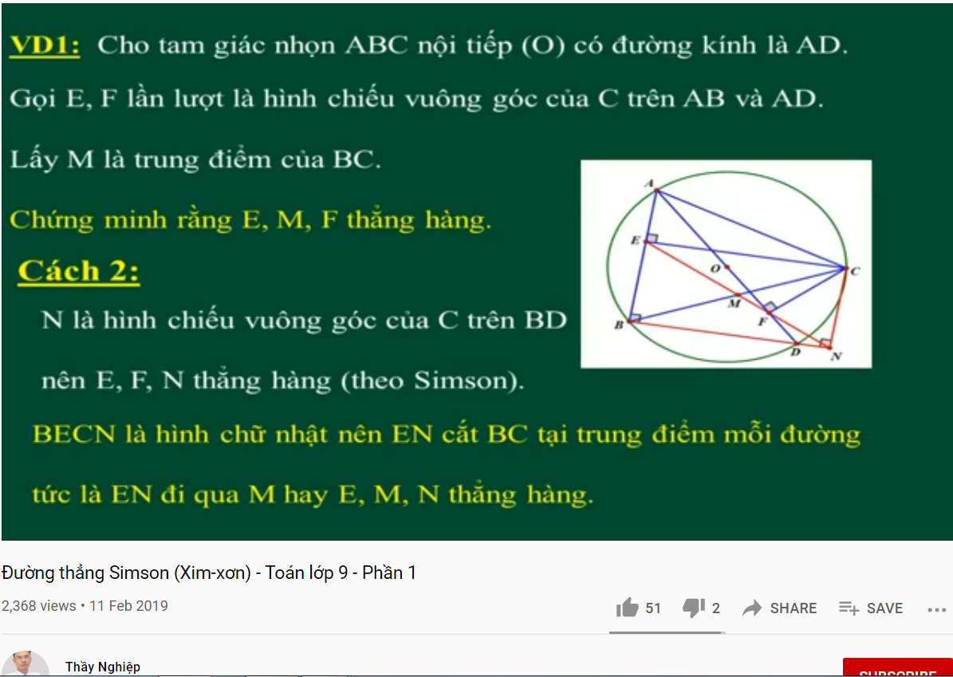
DUONG THANG SIMSON – Ap Dung

Slide 27
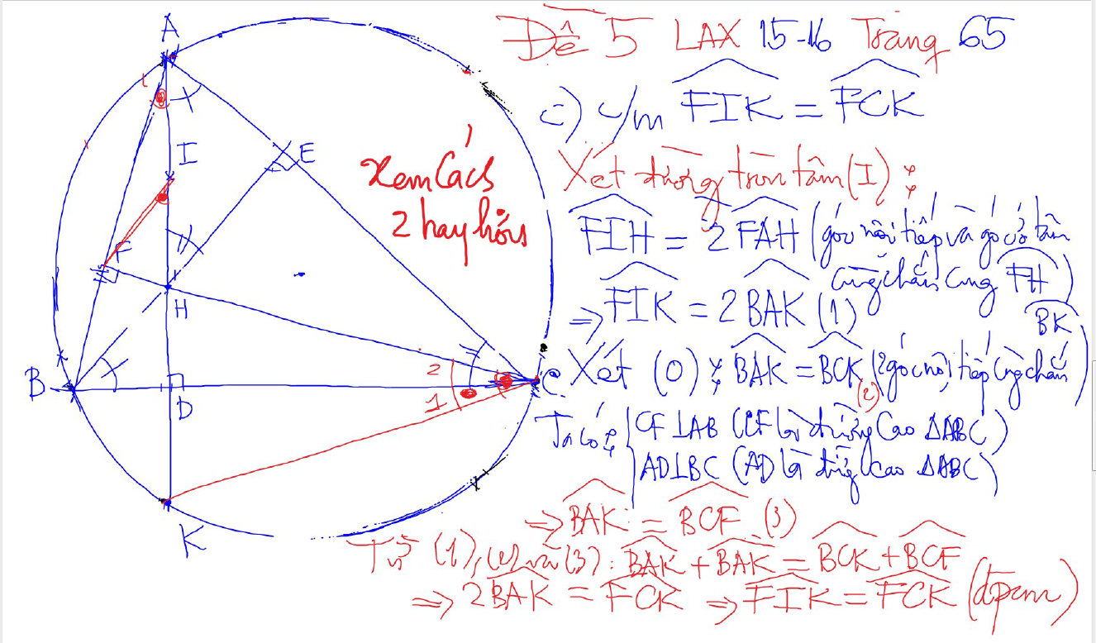
DUONG THANG SIMSON – Ap Dung

Slide 28
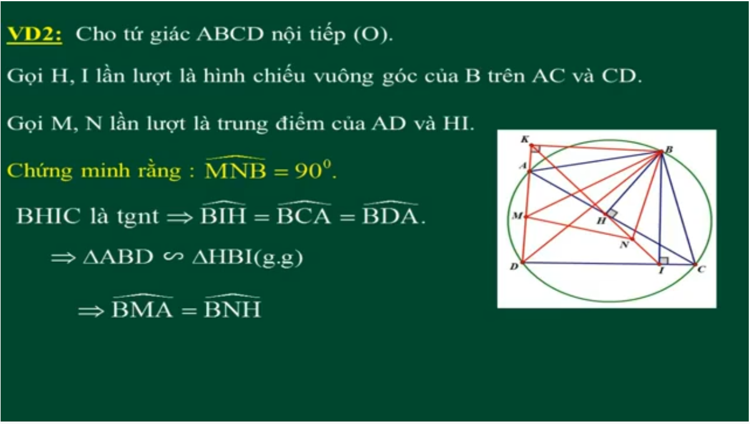
DUONG THANG SIMSON – Ap Dung

Slide 29
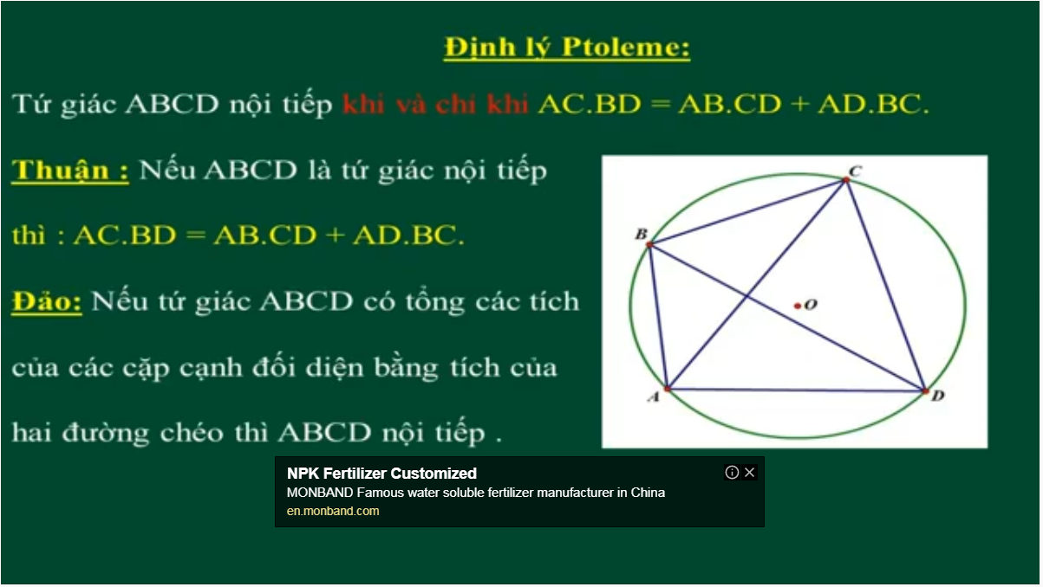
Bai 54 De Cuong – Kinh dien tam giac nhon 1 (xem trong thu muc Tu Giac Noi Tiep)

Slide 30
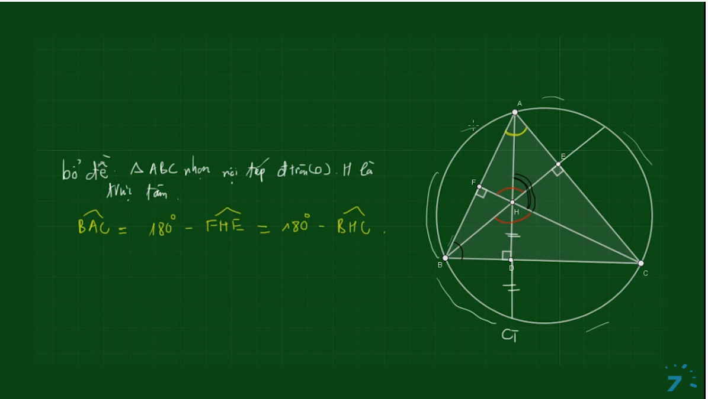
Bai 54 De Cuong – Kinh dien tam giac nhon 1 (xem trong thu muc Tu Giac Noi Tiep)

Slide 31
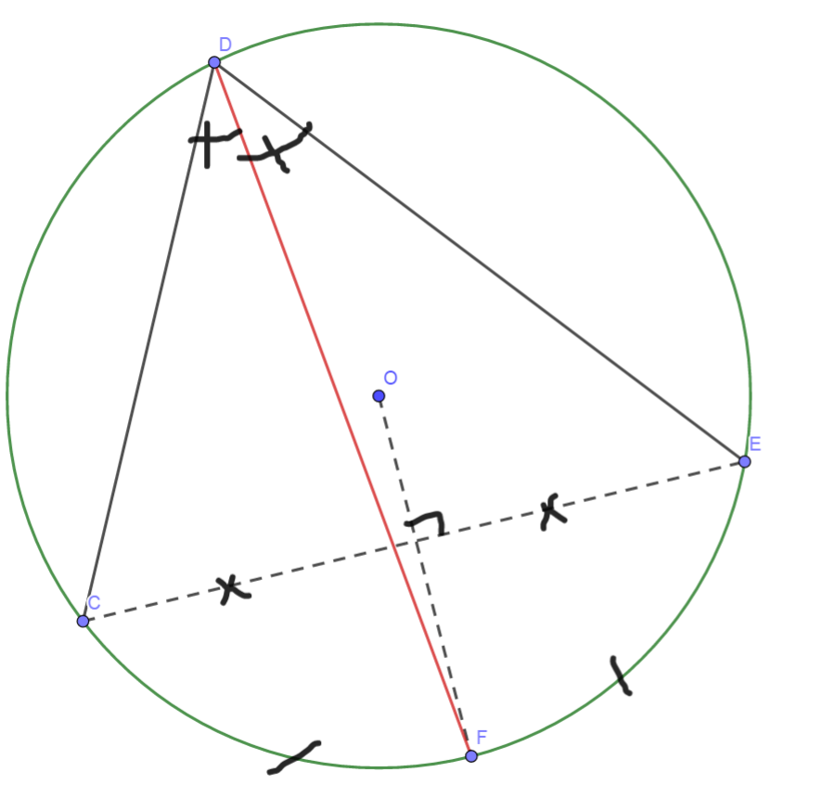
Cach ve duong phan giac cua goc noi tiep

Slide 32
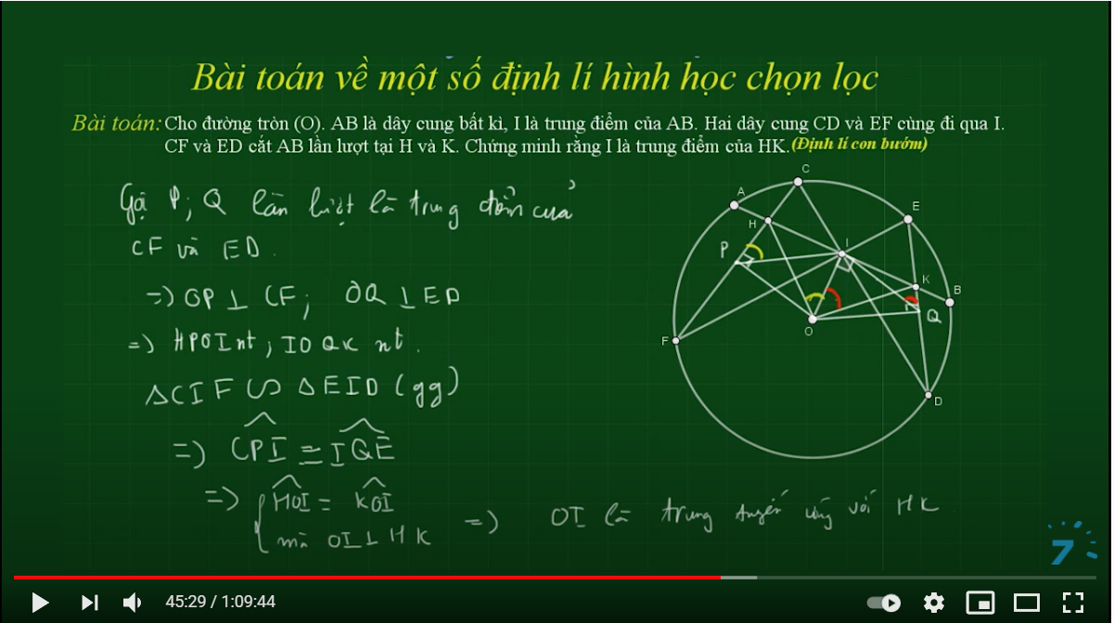

Slide 33
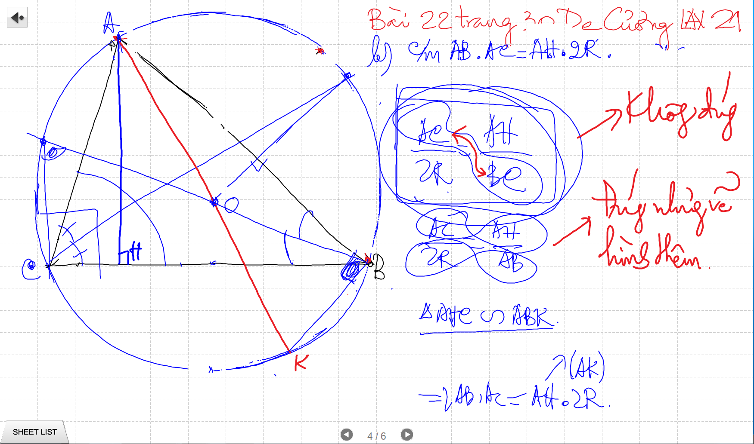

Slide 34
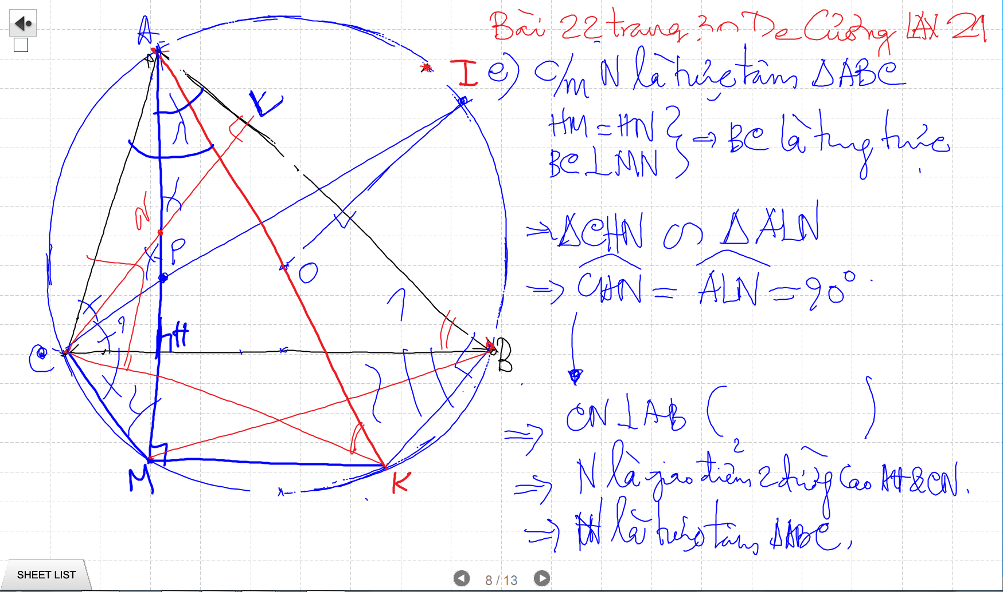

Slide 37
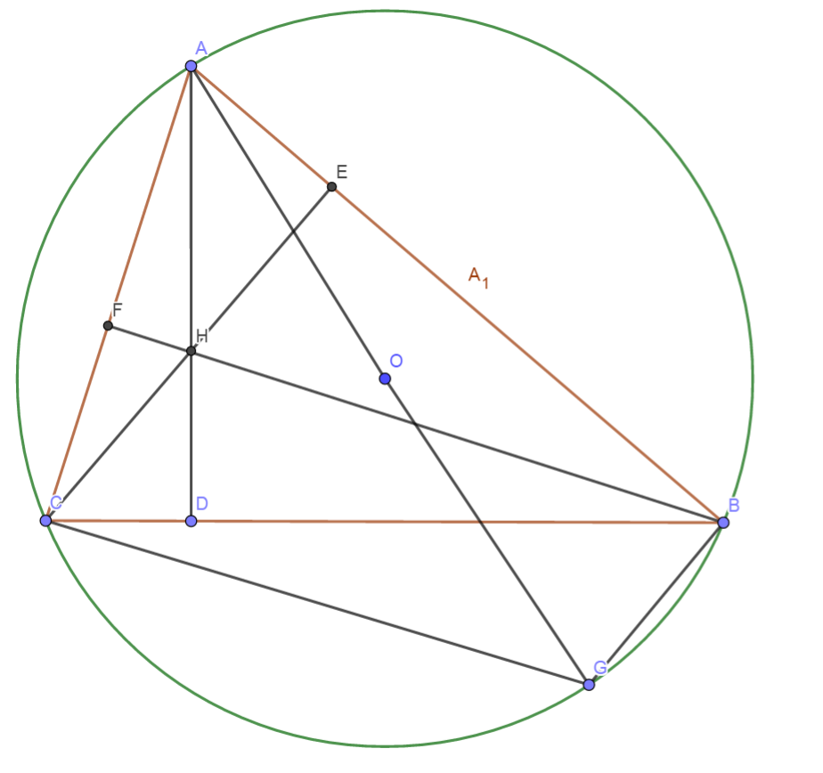
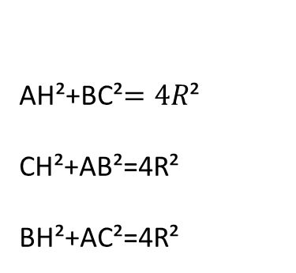
Quan he giua canh day va khoang cach den truc tam
AH²+BC²$=4R$²
CH²+AB²=4R²
BH²+AC²=4R²

Slide 38
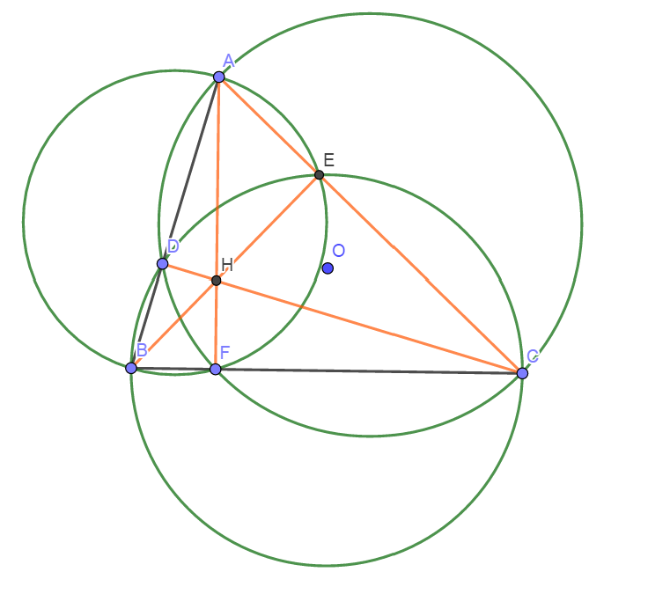
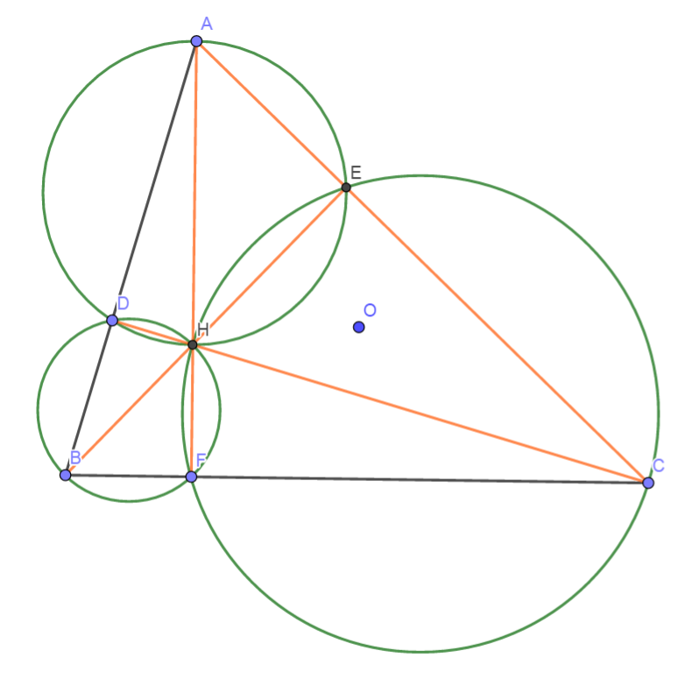
Truc Tam: 6 tu giac noi tiep

Slide 39
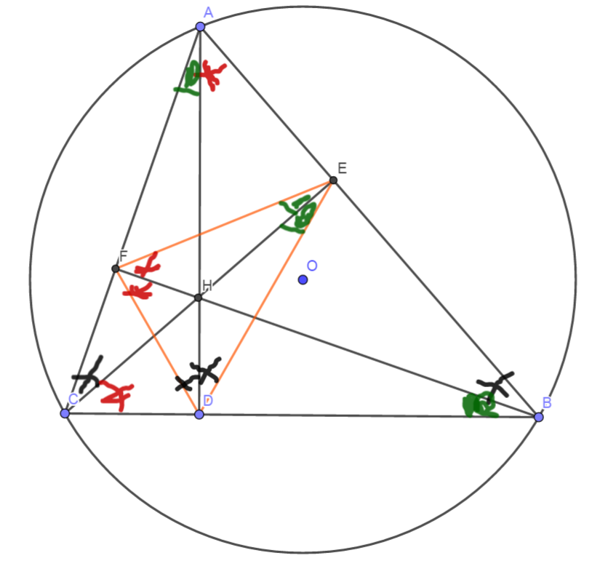
Truc tam: Tinh chat chan 3 duong cao
Chan 3 duong cao tao thanh tam giac DEF
3 duong cao cua tam giac ABC cung la 3 duong phan giac cua tam giac chan duong cao (DEF)
3 tam giac nho o 3 dinh (3 cai banh u) dong dang voi tam giac lon

Slide 40
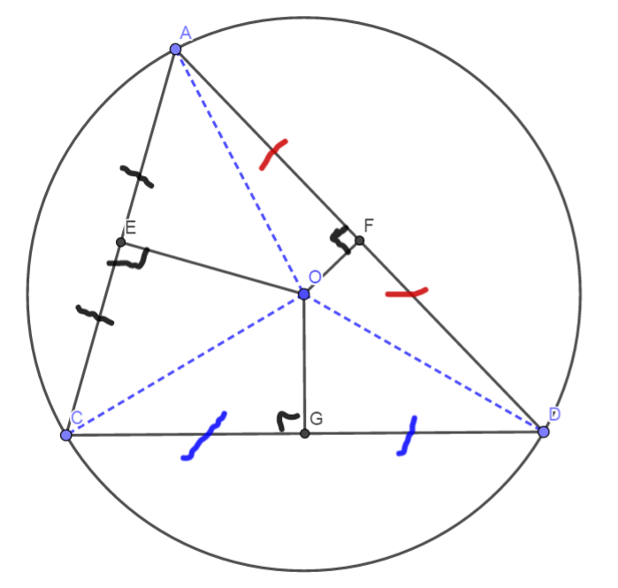
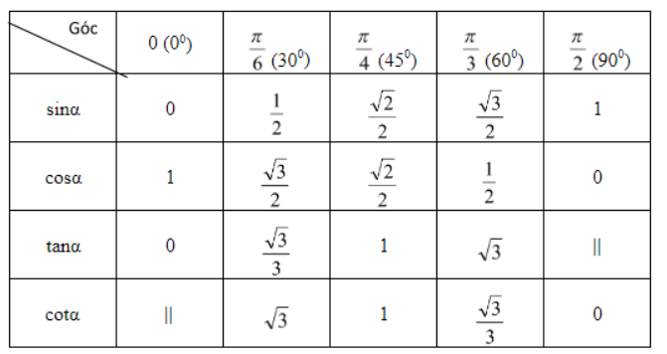
3 duong trung truc dong qui, la tam cua duong tron ngoai tiep tam giac
Giao diem cua 3 duong phan giac la tam duong trong noi tiep tam giac

Slide 41
